Slide 1


MINOR PROJECT REVIEW TOPIC : EARLY DETECTION AND PREVENTION OF PARALYSIS ATTACK
TEAM MEMBERS:
U.S VARSHINI (927622BEC243)
P.SRINITHI (927622BEC204)
P.SUBISHA (927622BEC211)
L.SURUTHI (927622BEC222) GUIDED BY :
Dr. S. SIVARANJiNI

Slide 2
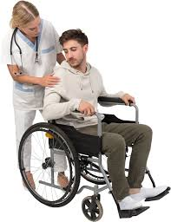
OBJECTIVE
Monitoring the health data to continuously track users’ after COVID-19 vaccination to detect early signs of severe side effects, especially strokes and paralysis attack.
Primary objectives:
Minimize disability
Reduce long-term complications
Improve treatment outcomes

Slide 3
LITERATURE SURVEY
A health data information & management system via A mobile app streamlines patient care by managing health records, scheduling appointments, enabling telemedicine, and integrating wearable devices for real-time monitoring.
It enhances efficiency, ensures data privacy, supports emergency services, and provides personalized health insights, making healthcare accessible and convenient for users.

Slide 4
ABSTRACT
This project introduces a health monitoring tool designed to detect early signs of paralysis using mobile phones. It combines ML, DL and NLP techniques to assess neurological health through several tests:
CNN detect pupil dilation and contraction.
Hugging face's transformer models analyze speech patterns for irregularities.

Slide 5
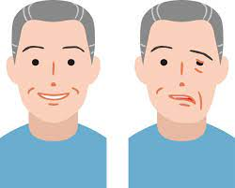
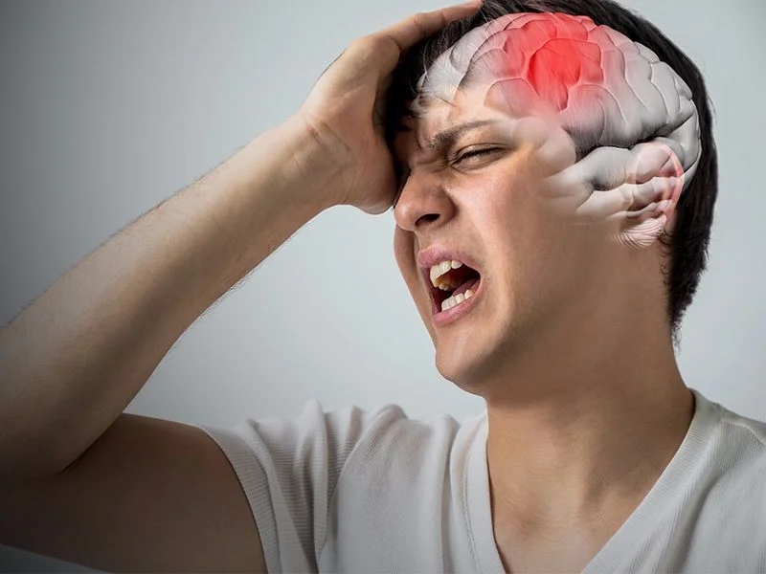
Pose estimation evaluates body movements during exercise tasks.
Cognitive tests assess mental ability and response time.
Blood pressure data integrates with test results for a comprehensive health view.
The app provides an early warning system for paralysis, helping users monitor their health and take timely action.

Slide 6
Flow chart
Pose estimation test
Patients
Eye pupil length detection
Repeat once in 2 months
Tests planned
Speech test
Blood pressure
Diagnose
No
Cognitive brain test
If positive
Yes
Approach hospital immediately

Slide 7
REFERENCE
https://www.ncbi.nlm.nih.gov/pmc/articles/pmc9530738/ - Details known about paralysis
https://github.com/danielchristopher513/brain_stroke_prediction_using_machine_learning - reference code for developing app
https://www.kaggle.com/code/bakhromjumaniyazov/stroke-prediction- taken reports and datasets
https://www.healthline.com/health/facial-paralysis -
paralysis overview
https://codepen.io/-
developing and testing the website

